Slide 1
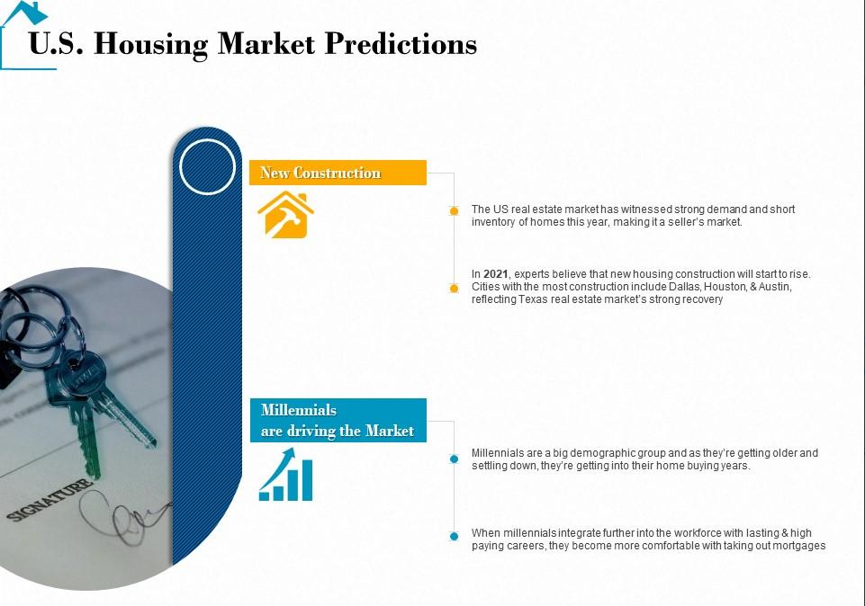
Housing Market Prediction Analysis – Milestone 4
Sri R Sankaranarayanan Bellevue University DSC630 Predictive Analysis

Slide 2

Introduction
Purchasing a house is a big decision in a person’s life and needs a considerable amount of thought and research. The goal of this Milestone 4 is to present my progress, work ahead to completing this analysis and present any challenges or roadblocks
to obtain feedback from peers.
.
Problem Statement
We are aiming to predict the housing price based on the historical Sale Price, Median Income, Number of Schools and their Rating, Crime Rate, Unemployment Rate, Number of Hospitals and their ratings
Project Scope
Building Predictive Analytics systems that can help individual home buyers choice and options to better plan for their first home buying process. The aim of the project is to provide the best counties/areas in the USA to invest in for a national real estate developer, individual buyers, banks looking for a place to develop a new apartment building or to purchase.

Slide 3
Predictive Analytics Approach
We are trying to predict the house prices using Machine learning algorithms XGBoost and Linear Regression considering factors such as Median income in a county, Crime rate in that county, public schools, hospitals, hospital ratings and unemployment rate in the county.
Data Source We will use many different data sources for Historical Sale price, Demographic data, Mortgage Interest rate, Crime Data, Schools data. The related datasets include:
Zillow Housing Price data
https://www.kaggle.com/zillow/zecon
DEMOGRAPHIC DATA
This dataset comprises demographic data like population, age, sex, race and income, published by the US Census Bureau.
https://www.census.gov/programs-surveys/acs
CRIME DATA This page contains the crime data by California cities, published by FBI.
https://www.kaggle.com/mikejohnsonjr/united-states-crime-rates-by-county
PUBLIC SCHOOLS DATA The page contains all active, pending, closed, and merged public schools and districts, also contains their corresponding Zip code, published by California Department of Education.
https://www.kaggle.com/carlosaguayo/usa-public-schools

Slide 4
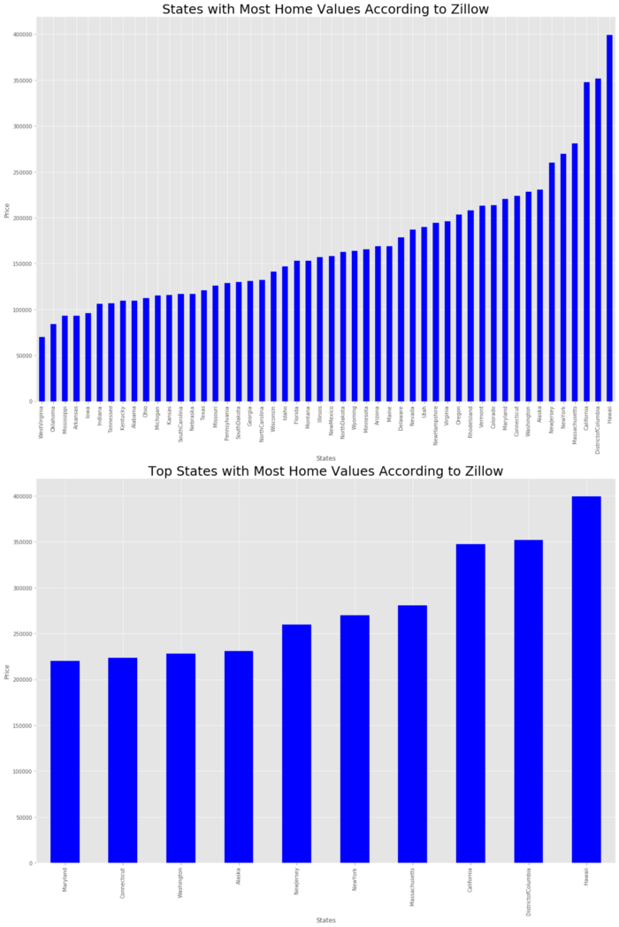
Data Understanding

Slide 5
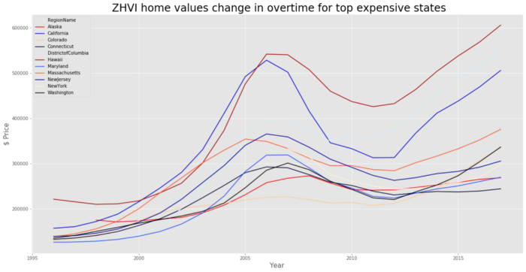
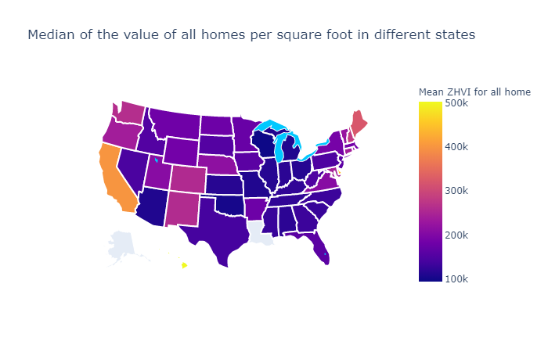
Data Understanding

Slide 6
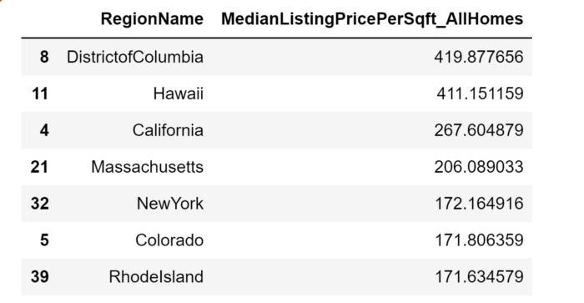
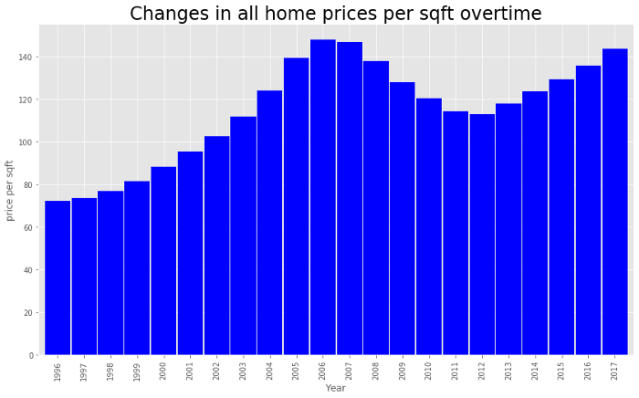
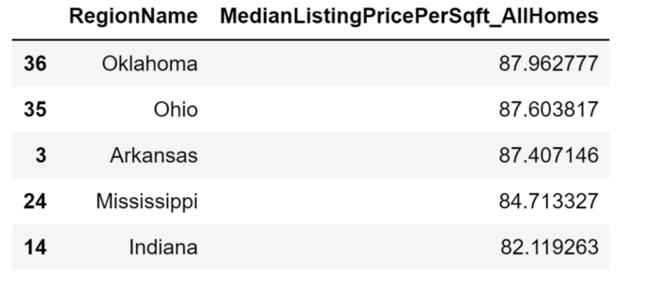
Data Understanding

Slide 7
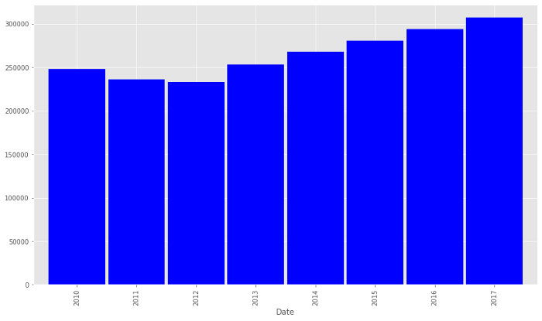
Data Understanding

Slide 8
Data Preparation and Feature Selection
Predictive Model with XGBoost and Linear Regression - For building predictive model of house prices with Zillow Economics dataset, I have used County_time_series data as it provides house prices for all homes in a county. Different factors considered for predicting the house prices are Median Income, Crime Rate, Public schools, Hospitals and Hospital ratings, Unemployment rate in that county.
As bagging algorithms, Random Forest and Extra Tree Classification were chosen, and XGBoost was picked as one of the boosting techniques. As one tree algorithm, the Decision Tree algorithm was used.

Slide 9
Challenges
Dataset and supplementary data are limited in Zillow and other estimates. This might cause challenges with accuracy on general population data
Finding all the dependent variables and how they affect the overall house price prediction would definitely be challenge
Dataset may be complete and needs to played around a lot.

Slide 10
Reference : https://www.kaggle.com/zillow/zecon https://www.kaggle.com/c/house-prices-advanced-regression-techniques/data https://finance.yahoo.com/news/housing-index-shows-renting-beats-193900999.html https://towardsdatascience.com/house-price-prediction-with-zillow-economics-dataset-18709abff896 https://www.section.io/engineering-education/house-price-prediction/ https://yalantis.com/blog/predictive-algorithm-for-house-price/ https://www.kaggle.com/erick5/predicting-house-prices-with-machine-learning/data https://rpubs.com/nweissm/670674

